Slide 1
Lecture #2
HTML continued in-depth

Slide 2
Some Resources to Help you
https://www.w3schools.com/tags/default.asp - List of All HTML Tags
https://github.com/gendx/html-cheat-sheet - HTML Examples & Syntax Help

Slide 3
Always Indent your Code
Indenting means starting your line of code further away from the page. This is used to highlight a parent / child relationship between the HTML Tags. You use the TAB key to indent.
<div> <h1>My name is Ali</h1> <p>I am a Web Developer</p> </div> | <div> <h1>My name is Ali</h1> <p>I am a Web Developer</p> </div>

Slide 4
Using the Chrome Developer Tools
All modern browsers come with powerful development tools that help you while writing your HTML, CSS and JavaScript code.
You can open the Chrome Development Tools using the CTRL + SHIFT + I keys.
The Development tools will show you all the HTML Elements on your Page and you can even edit them in real-time.

Slide 5
HTML Tag Attributes
There are some HTML tags that require more information than just the tag name to do their function properly. For example, we cannot put an image on the page without telling the <img> tag where the image is. To solve this problem we use HTML Attributes.
HTML Attributes are placed in the starting tag of the element, and they have a specific syntax of name="value"
For example, The <img> tag has an attribute of src that is used to specify where the image is.
<img src="my_photo.png">

Slide 6
HTML Element Display
There are 3 types of Basic Display Modes for HTML Elements.
Block - Block Element takes 100% width and pushes other elements to the next line. You can set specific width for block elements. e.g. <p>, <h1>
Inline - Inline Element only occupies the space that it needs. You cannot set specific width for inline elements. e.g. <span>, <a>
Inline-Block - Inline Block elements are just like Inline but can set a specific width.
You can change the Display Modes for all HTML elements using CSS. Which we will learn about in the future.

Slide 7
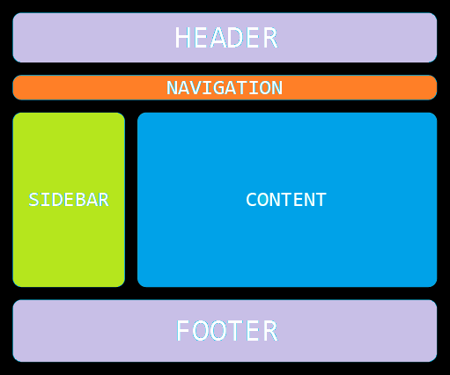
Block and Inline Elements on a Web Page
How a Web-page is structured with both Block and Inline Elements in conjunction with each other.

Slide 8
HTML Tables
<table>
<thead>
<tr>
<th>Name</th>
<th>Age</th>
</tr>
</thead>
<tbody>
<tr>
<td>Mudassar</td>
<td>19</td>
</tr>
<tr>
<td>Umar</td>
<td>21</td>
</tr>
</tbody>
</table>
Tables, just like in real-life are a great way to show structured data in HTML.

Slide 9
HTML Forms
<form>
<div>
<label>Username</label>
<input type="text">
</div>
<div>
<label>Password</label>
<input type="password">
</div>
<button>Login</button>
</form>
Forms are HTML Elements that let you collect input from the user. For example a Contact Form or a Sign up Form.

Slide 10
Hands on Practice!

